Slide 1
Single Page Applications with ASP.NET Core
Jeffrey T. Fritz
Sr. Program Manager
@csharpfritz
jefritz@microsoft.com

Slide 2
Comparison: standard page requests
Client Browser
Request: http://site.com/products/
Web Server
HTML
CSS
Images
Javascript
Response: Full page
Request: http://site.com/products/6
Response: Full page
HTML
CSS
Images
Javascript

Slide 3
Comparison: Single Page Application
Client Browser
Request: http://site.com/products/
Web Server
HTML
CSS
Images
Javascript
Response: Full page
Request: http://site.com/products/6
Response: Tiny bit of data
{product}

Slide 4
Why are we building SPAs
User Experience
Resume Building
Keeping Up With Other Web Devs
They’re Way Easier!

Slide 5
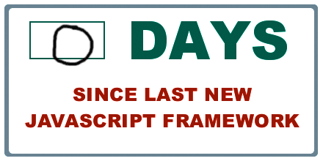
SPA Challenges
Concept Count Explosion
New Framework Every Day
Working with multiple languages
Managing state
Managing resources
Managing resource pipeline

Slide 6
Single Page Applications
Frameworks

Slide 7

AngularJS
<!doctype html>
<html ng-app="app">
<body>
<tabs>
<pane title="Localization">
Date: {{ '2013-04-01' | date:'fullDate' }} <br>
Currency: {{ 123456 | currency }} <br>
Number: {{ 98765.4321 | number }} <br>
</pane>
<pane title="Pluralization">
<div ng-controller="BeerCounter">
<div ng-repeat="beerCount in beers">
<ng-pluralize
count="beerCount“
when="beerForms">
</ng-pluralize>
</div>
</div>
</pane>
</tabs>
</body>
</html>
Custom Tag Attributes
Powerful Directives
Declarative Style
Strict Separation

Slide 8

React
Not MVC – Just V (UI)
Virtual DOM
One-way data flow
var HelloMessage = React.createClass({ render: function() { return <div>Hello {this.props.name}</div>; } }); ReactDOM.render(<HelloMessage name="John" />, mountNode);

Slide 9

Vue.js
<div id="app-6">
<p>{{ message }}</p>
<input v-model="message">
</div>
Approachable
Versatile
Performant
var app6 = new Vue({
el: '#app-6',
data: {
message: 'Hello Vue!'
}
})

Slide 10
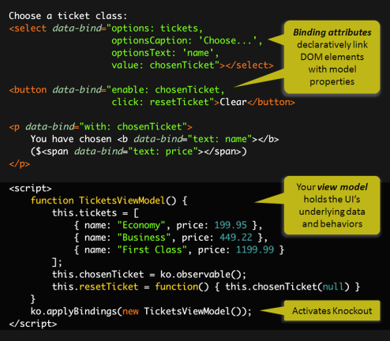
Knockout.js
Declarative Bindings
Automatic UI refresh
Dependency Tracking
Templating

Slide 11
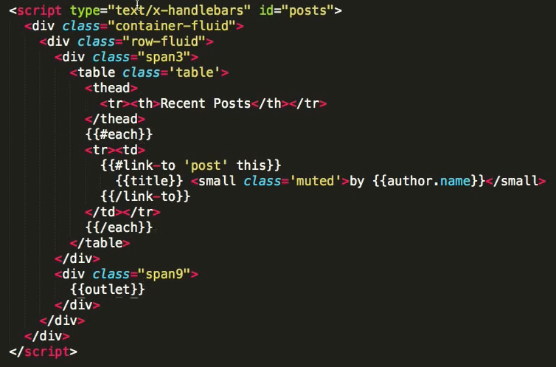

Ember.js
Ember is a framework
Convention over config
URLs are important

Slide 12
JavaScript Tools

Slide 13
Grunt / Gulp Overview
Front-end task runners
Bundle and minify CSS / JS
Run transpilers (JSX / LESS / Sass / Coffeescript / etc.)
Copy files (e.g. from bower_components to wwwroot)
Run tests (JS unit tests, browser automation tests)
Grunt and Gulp are both supported by Visual Studio

Slide 14
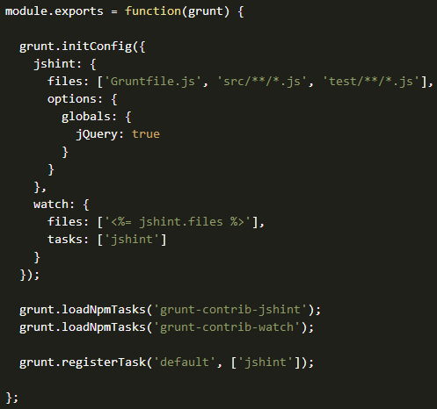

Grunt
JavaScript Task Runner
Automates minification, unit testing, compilation, etc.
Configuration over code
Common tasks already available as Grunt Plugins

Slide 15
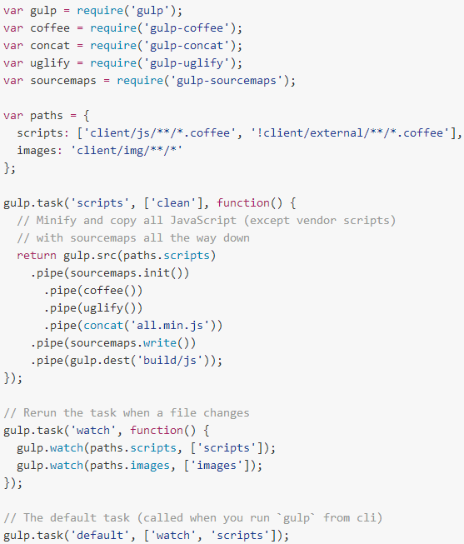

Gulp
Another JS Task Runner
Code over config
Streaming build system
Tasks are executed in maximum concurrency

Slide 16
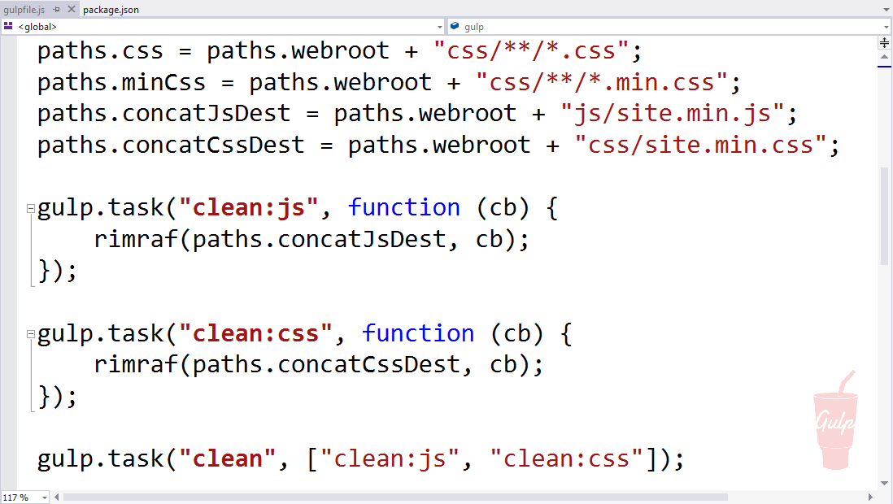
Visual Studio Support for Grunt / Gulp

Slide 17
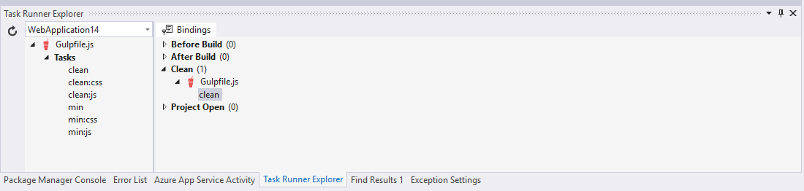
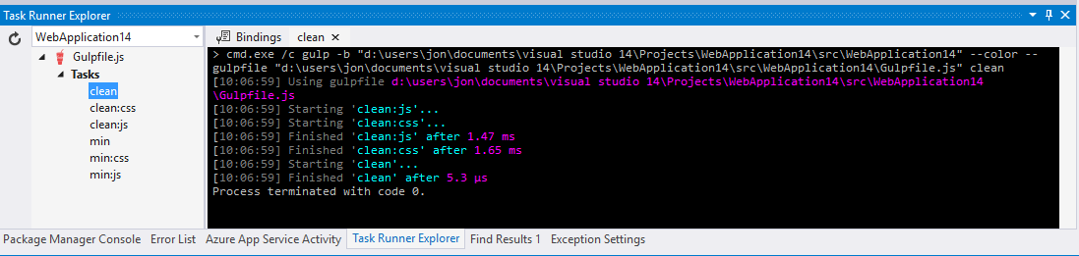
Visual Studio Support for Grunt / Gulp

Slide 18
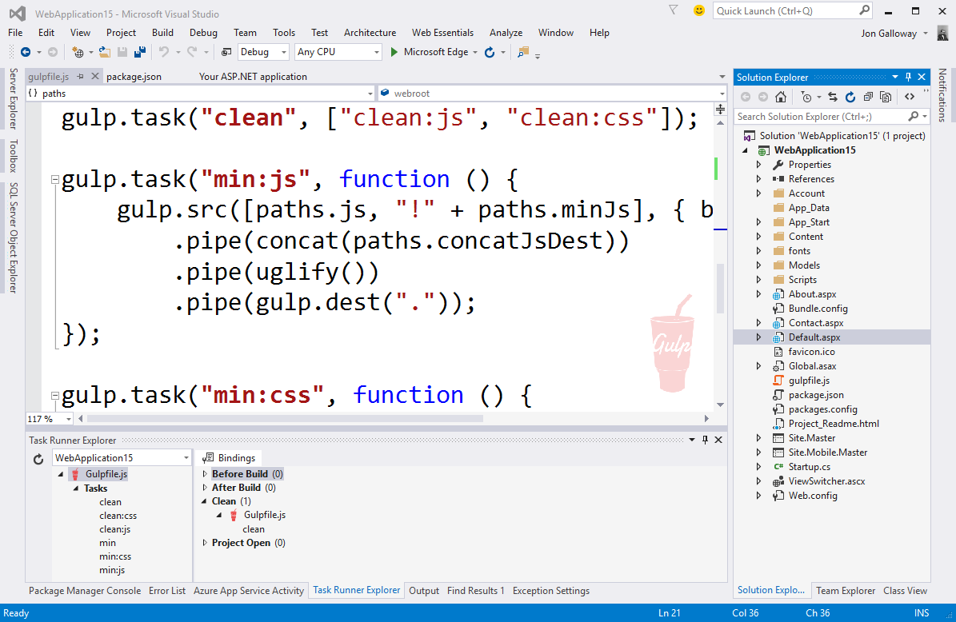
Works with all web project types
ASP.NET Core 1.0
ASP.NET 4.x Web Forms
ASP.NET MVC 5
HTML / Web Sites
Node.js
PHP
etc.
Notes:
This support is built in to Visual Studio, so it works with ASP.NET 4.x projects, Web Forms, etc.

Slide 19
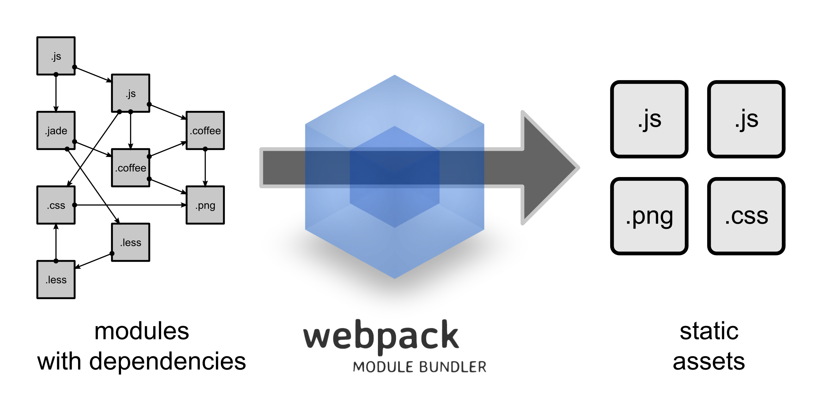
Web Pack

Slide 20
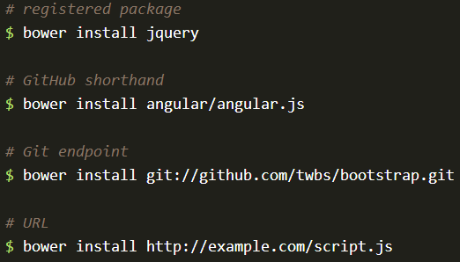

Bower
The package manager for the Web
50k existing users
>25k packages
Notes:
See http://bower.io/stats/

Slide 21
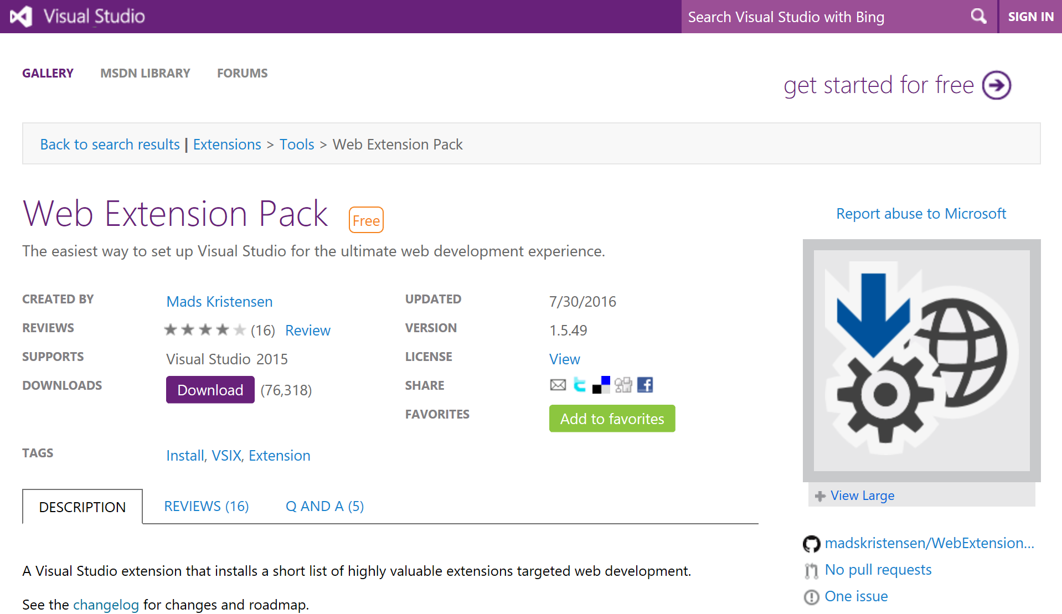

Slide 22
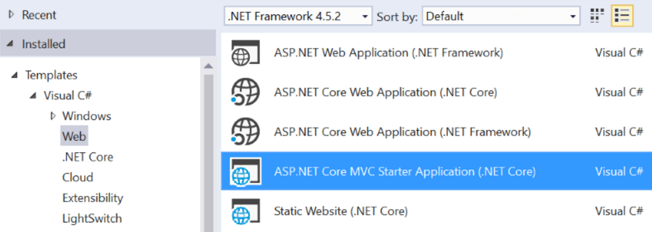
ASP.NET Core Template Pack
Templates
ASP.NET Core MVC Starter Application
ASP.NET Core + Angular 2
Vue.js with Webpack
Static Website
and more to come...

Slide 23

Yeoman

Slide 24
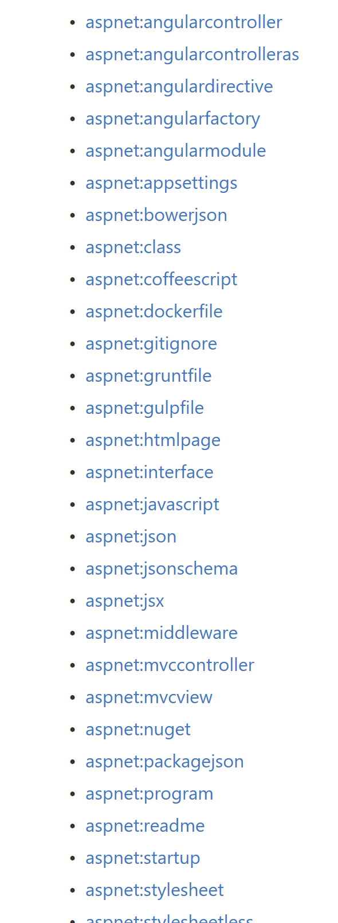
Yeoman Generators
https://github.com/OmniSharp/generator-aspnet
https://github.com/OmniSharp/generator-aspnet/wiki/how-to-try-local-changes

Slide 25
JavaScriptServices
Useful infrastructure for SPA’s on ASP.NET Core
Hosts Webpack to compile and serve client-side code
Advanced features like Hot Module Reloading and client / server side routing integration
Can invoke arbitrary NPM packages from .NET code
https://github.com/aspnet/JavaScriptServices

